Slide 1
Certification Process

Slide 2
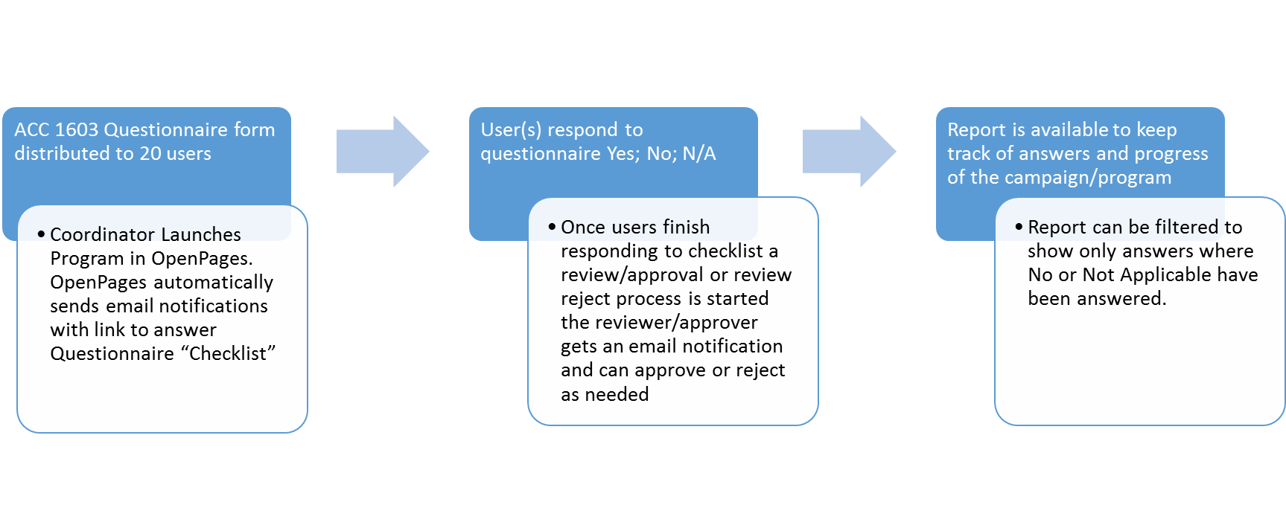
Financial Close Checklist

Slide 3
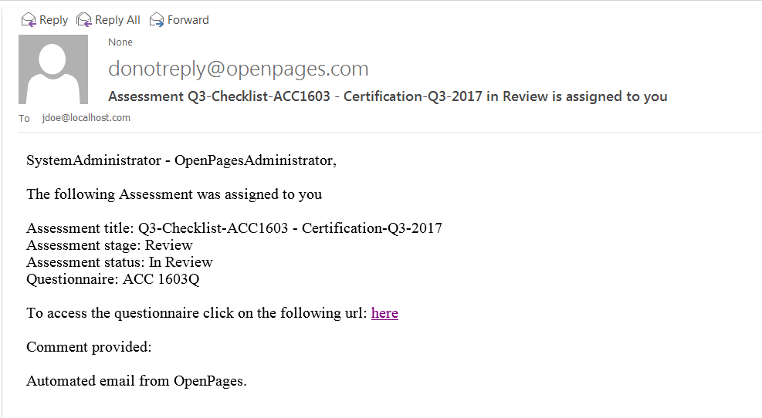
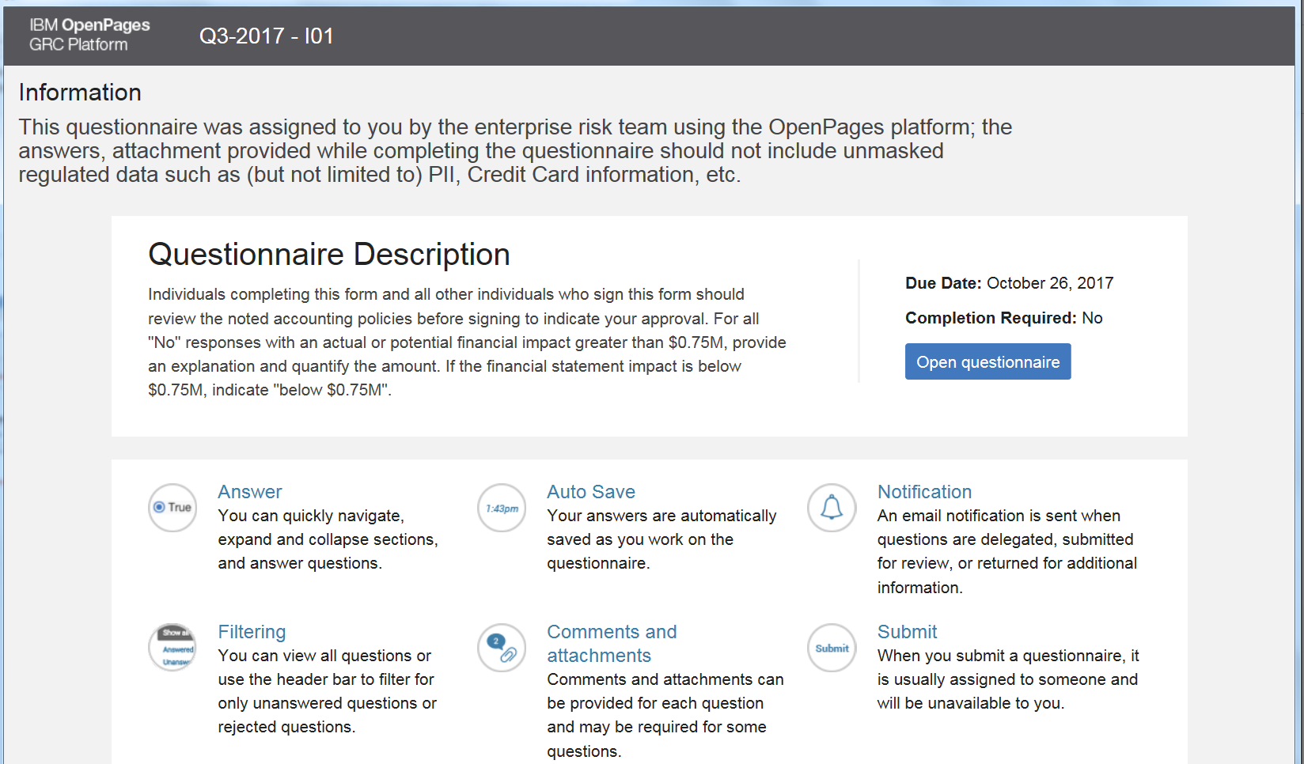
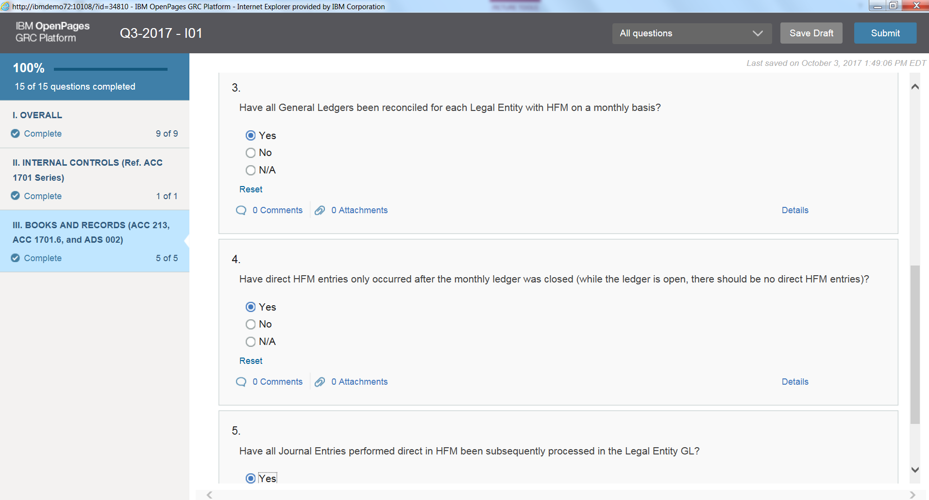
Example
Email notification to end users:
Clicking on link takes to login page and once in logged on a screen to open or review questionnaire shows up
Users interact with questionnaire answering each question and when they are done click submit for the review and approval

Slide 4
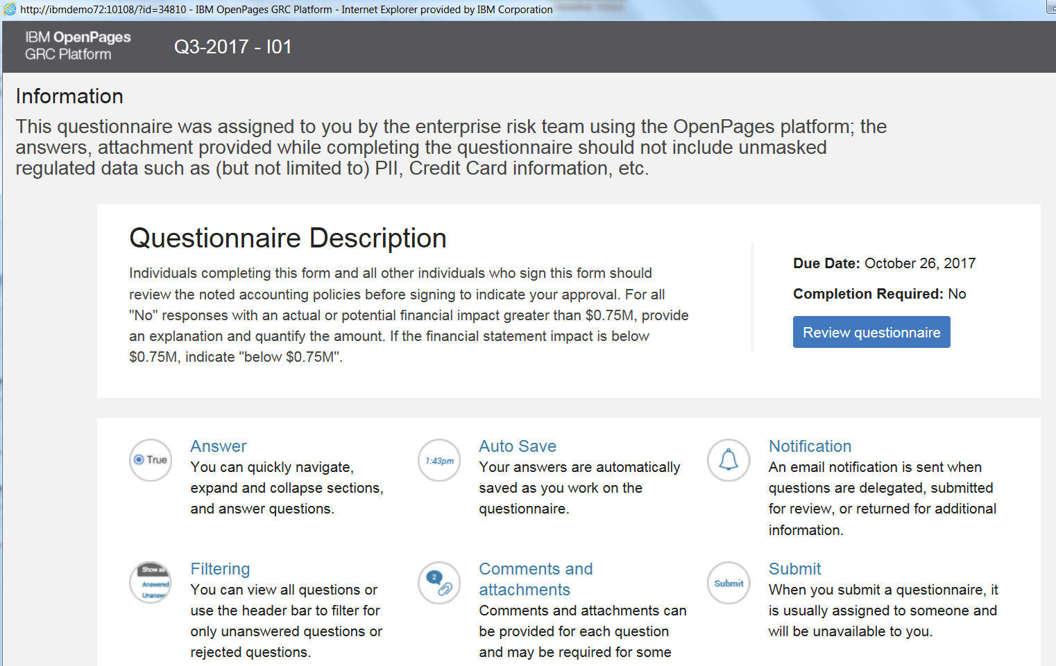
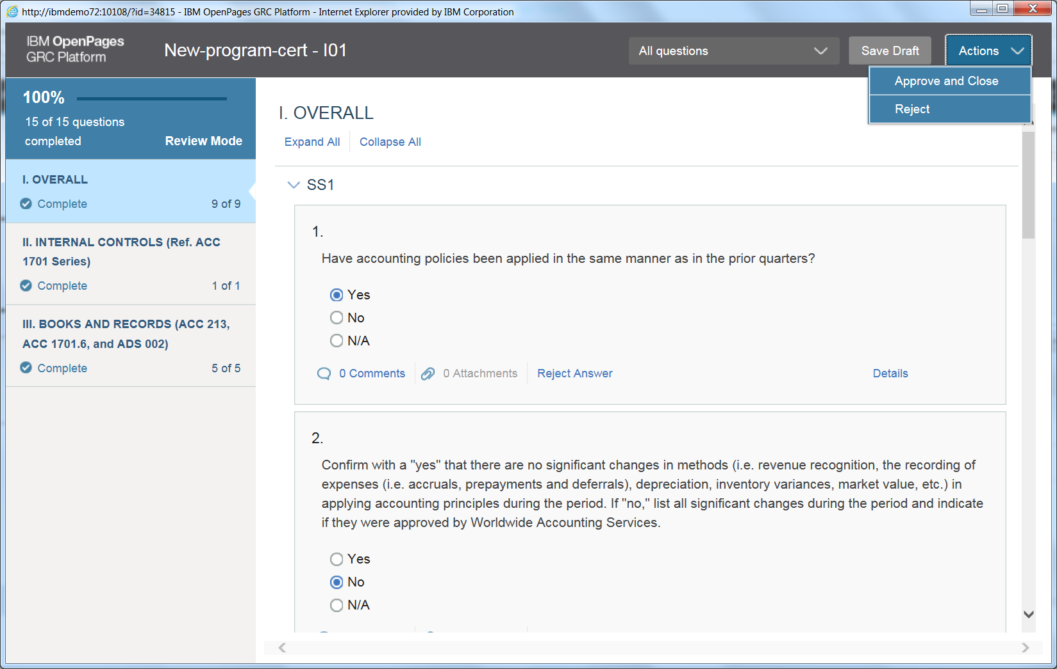
Example Review/approve
Email notification to Reviewer:
Clicking on link takes to login page and once in logged on a screen to review questionnaire shows up
Reviewer can approve and close or reject (rejecting will send questionnaire back to initial respondent)

Slide 5
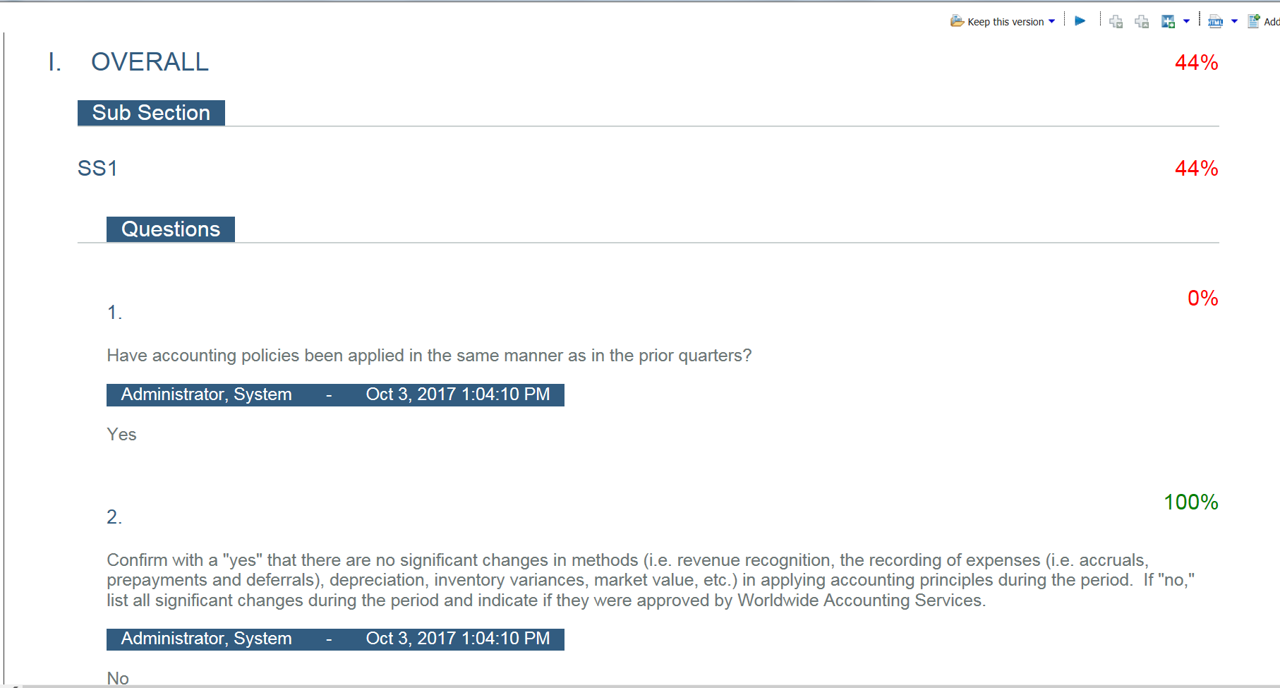
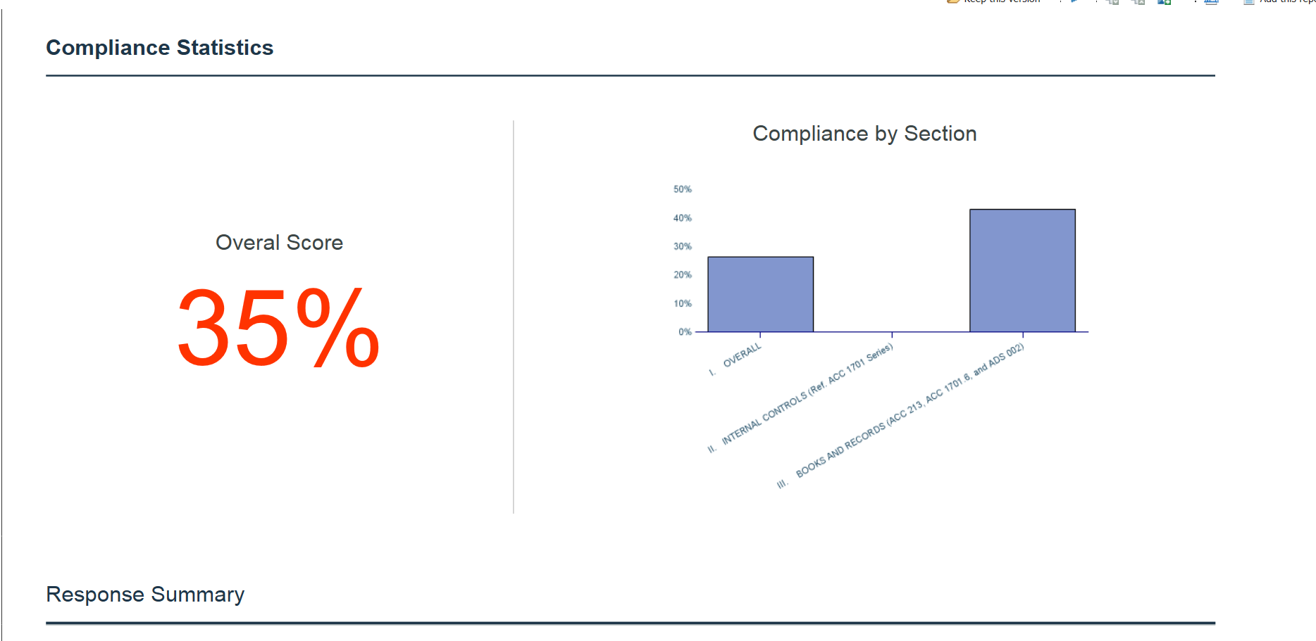
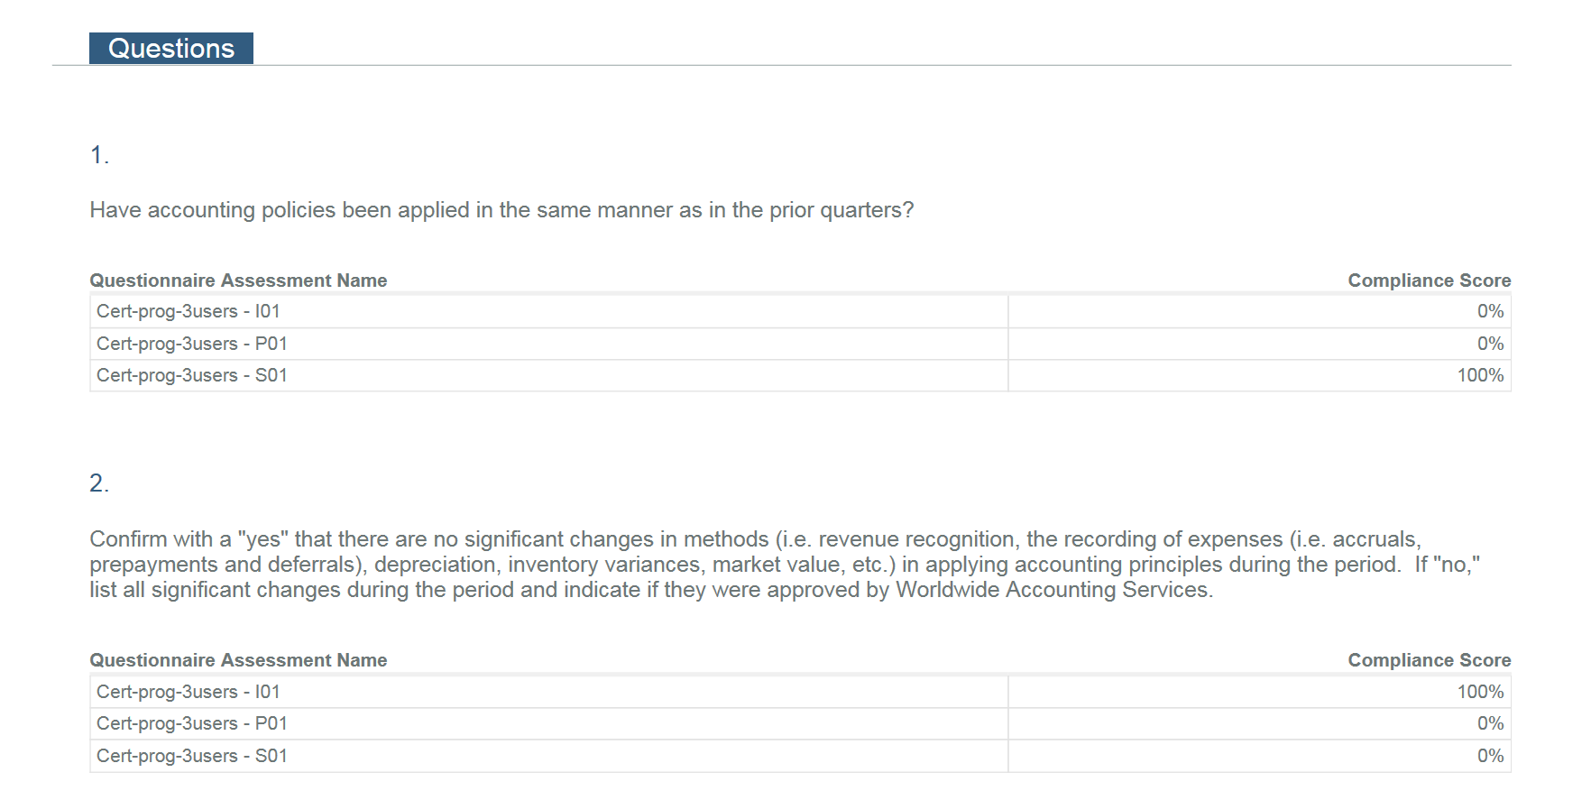
Example Report
A report output in pdf format presents per checklist each response and date/time of response:
A report at the program or campaign level can also be pdf’d to list an aggregated view of responses per section, all answers “YES” means 0 answers with No or N/A are weighted for instant visibility.
Report can have granular view at each question level. In this example there are 3 respondents per question (yes=0; no=100)

Slide 6
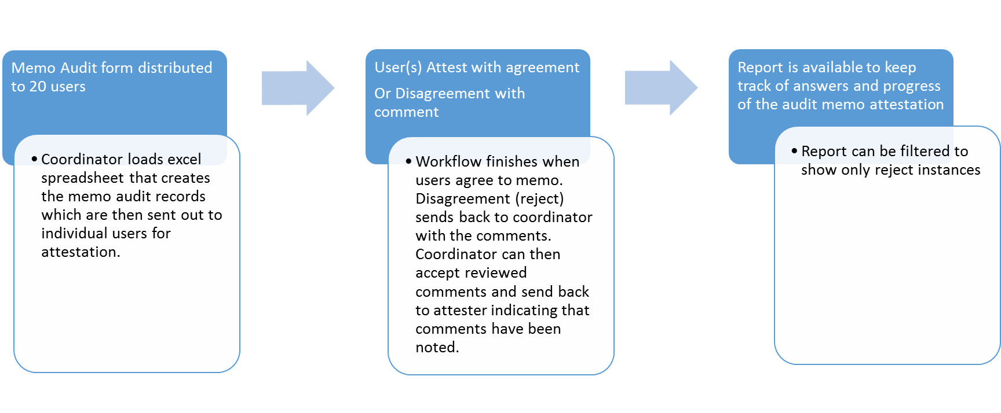
Certification Memo Audit

Slide 7
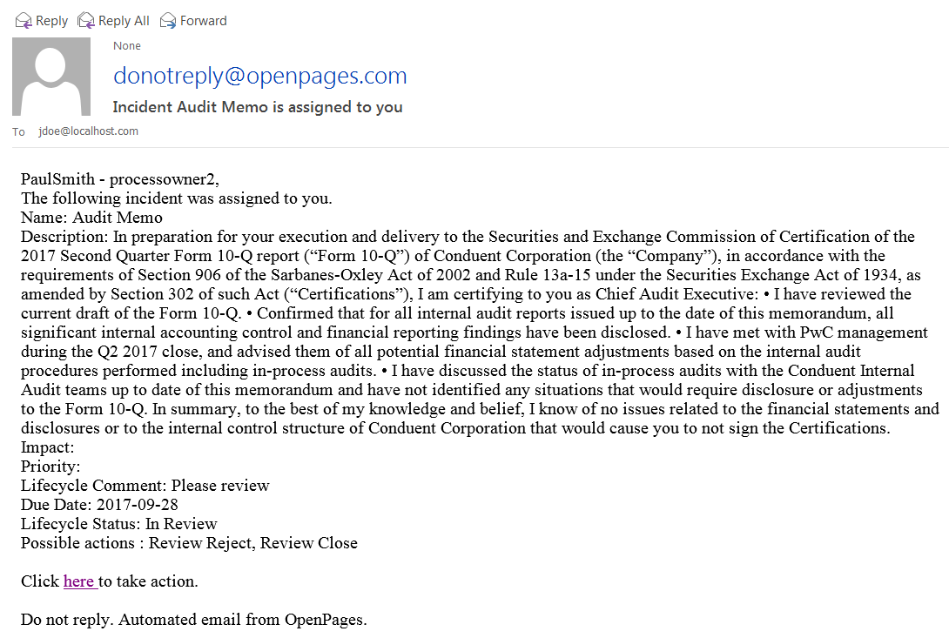
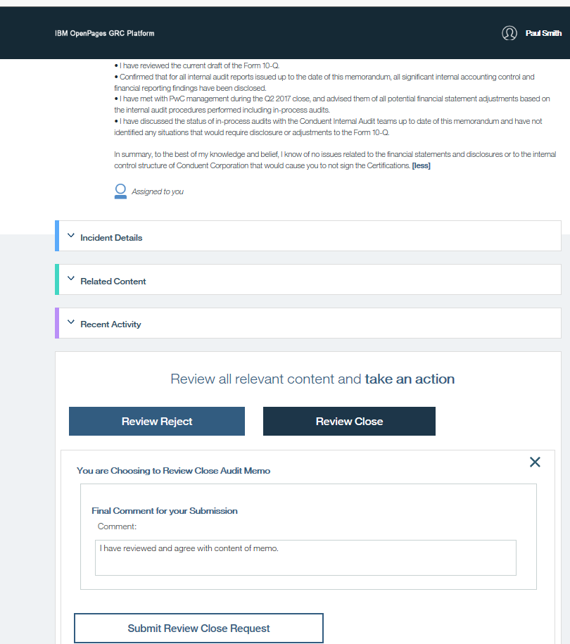
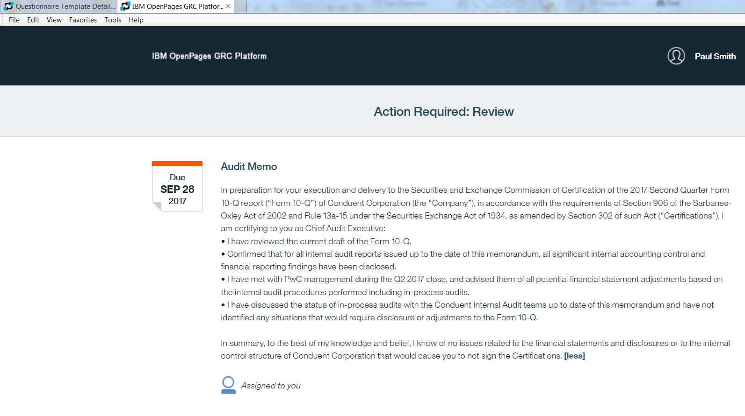
Example
Email notification to end users:
Clicking on link takes to login page and once in logged on a screen with the memo narrative shows up.
Users have options to agree or disagree (message on buttons can be tailored with your message i.e. agree disagree or attest reject, and allows to capture any comment

Slide 8
Business Unit Certification
User Role of Group Chief Accountant Attest with agreement
Or Disagreement with comment
User role of Group CFO attest with agreement or Disagreement with comment
  Coordinator loads excel spreadsheet that creates the Business Unit Certification Records and links to a master Word Document stored in the OpenPages Library repository Assume one word Doc per Business Unit. Upon creation of records emails which are then sent out to individual users for attestation.
  Agreement sends the workflow for final review and close to the next level user identified as “Group CFO” role.
  Disagreement sends back with comments to initiator or user role identified as “Group President or Managing Director”
  Agreement closes the workflow with option to capture comment.
  Disagreement captures comment and sends workflow back user role of group Chief accountant.
  Report can be filtered to show only reject instances from each stage.
Business Unit Certification records created with link to each BU word document.
Report is available to keep track of answers and progress of the Business Unit Certification

Slide 9
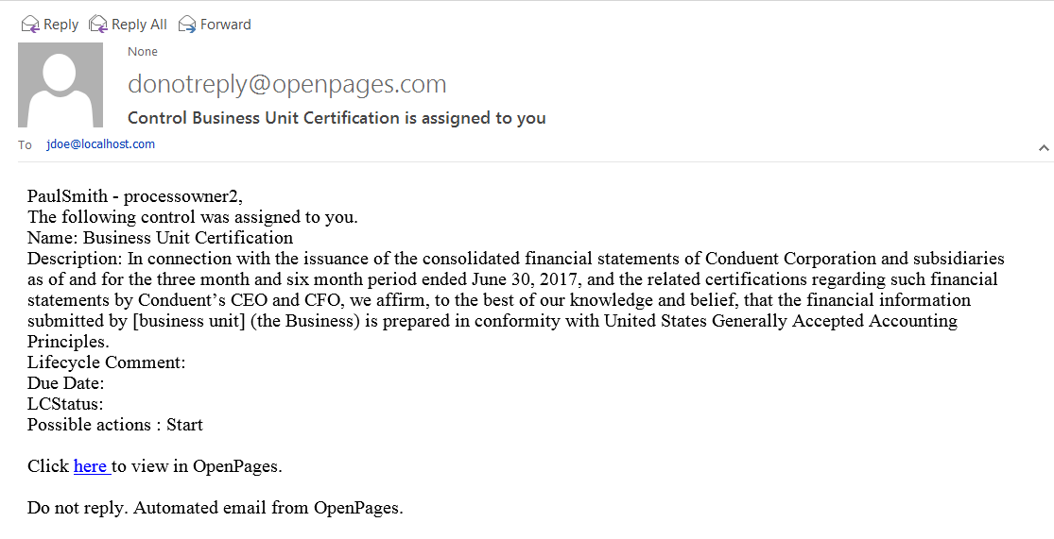

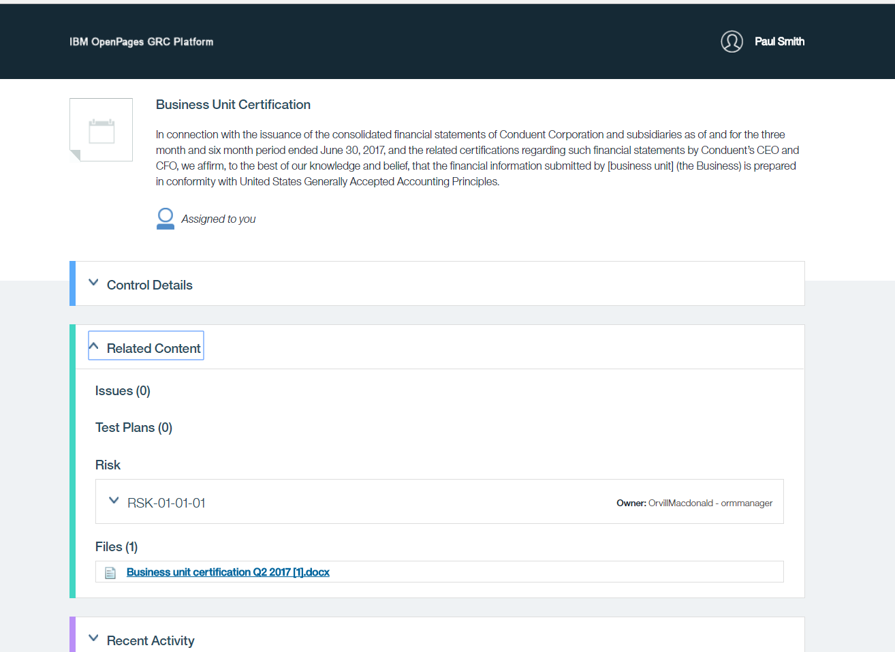
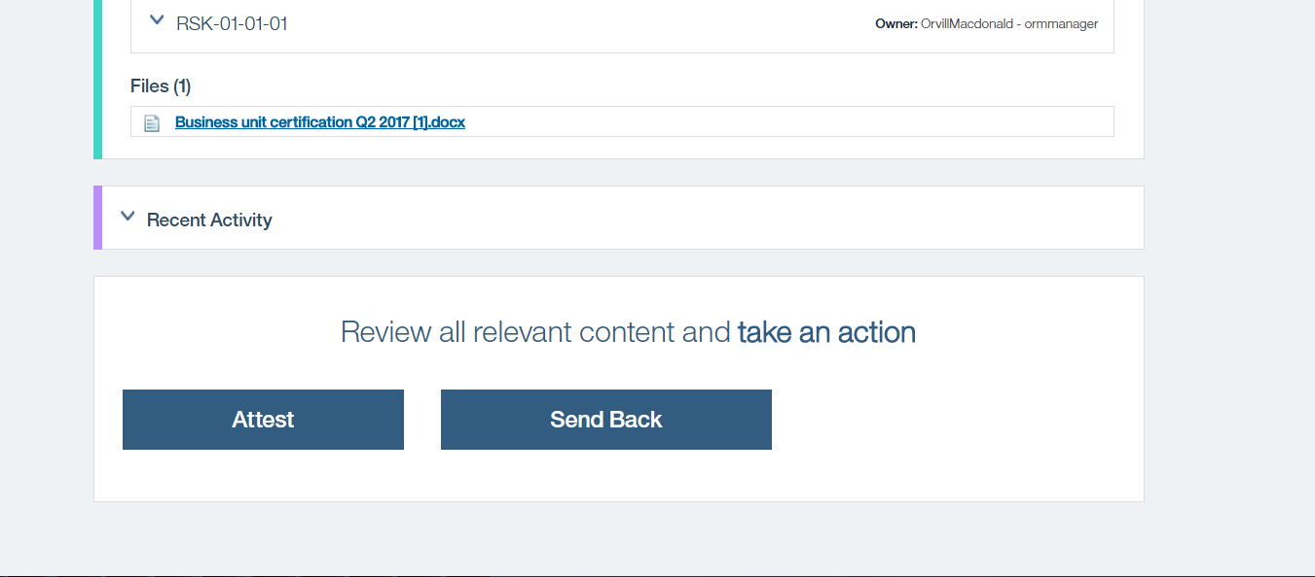
Example
Email notification to end users:
Clicking on link takes to login page and once in logged on a screen with the Business Unit Certification High Level Description and attached Word Doc shows up.
Users Can then click on the link to download and view the Word Doc and attest or send back, each of the option will allow for the capture of comments. Attest will progress the workflow to the next level of review and final approval whereas Send back will email back to the Group Manager role

Slide 10
Accounting Rep Letter Attestation
User Role certifier Attester attests to Accounting Rep Letter
User role of Approver/Reviewer does final approval
  Coordinator loads excel spreadsheet that creates the Accounting Rep Letter attestation records and links to a master Word Document stored in the OpenPages Library repository Assume one word Doc per Business Unit. Upon creation of records emails are then sent out to individual users for attestation.
  Agreement sends the workflow for final review and approval
  On disagreement option a set of fields will show up to capture what are the potential disclosure matters; Detailed Description Of Potential Disclosure Matters; Process in Place to ensure Accuracy of Period End Financial Reporting .
  Final Approval Closes the workflow.
  Manual Process involved here where the coordinator will go to the attestation record. Check out the word doc of the attestation letter make the modifications check back in the word doc and resubmit attestation workflow.
Accounting Rep Letter attestation records created with link to each BU word document.
User Role certifier Attester Disagrees to Accounting Rep Letter
Coordinator appends information to Accounting Rep Letter and sends back to attester
  Disagreement notice is sent to assigned coordinator along with the text field boxes that have captured information such as: Potential Disclosure Matter ; Detailed Description Of Potential Disclosure Matters; Process in Place to ensure Accuracy of Period End Financial Reporting

